Slide 1
Use of Isotopic Analysis and CMAQ Modeling to Categorize Dust Emission Sources in Utah
Micah Marcy, Zachary Lawless, Greg Carling, Bradley Adams
Brigham Young University
Air Quality Research Lab
2022 CMAS Conference
October 17-19, 2022

Slide 2
Utah Dust Emissions
Utah dust emissions driven by weather events
Impairs visibility
Causes health issues
Impacts mountain snowpack and water chemistry
Can change local ecology
Emissions impacted by natural and manmade factors
Weather
Land type
Land use
2
Notes:
MAKE SURE IT’S EMBEDDED (runs without internet); storm front from NW

Slide 3
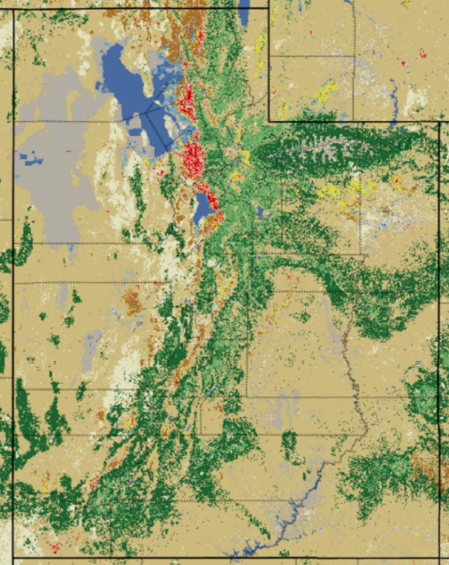
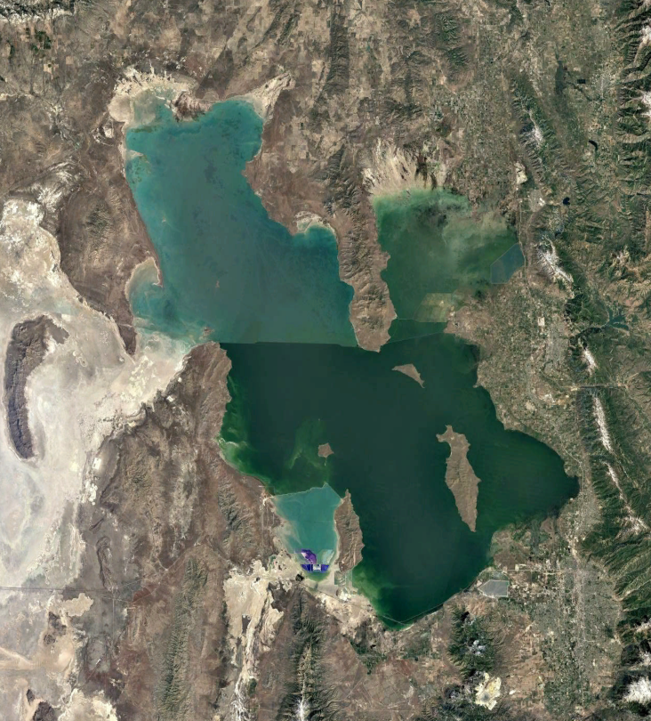
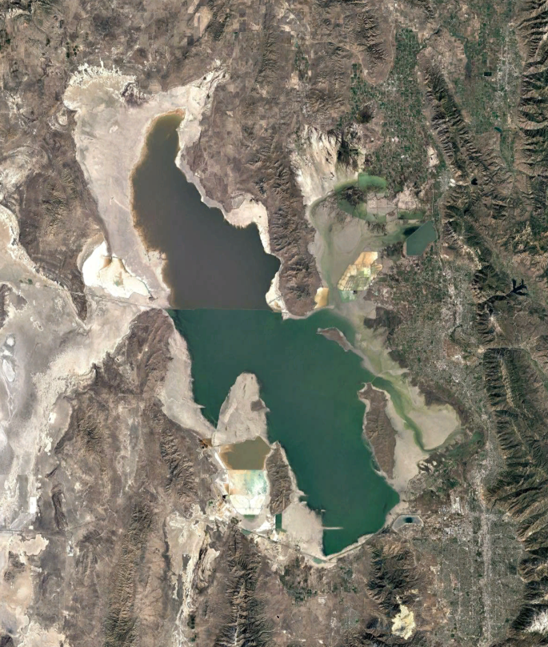
Main Dust Sources
90% of Wasatch Front dust from playas (Goodman et al., 2019, Chem Geol)
Great Salt Lake Desert, Sevier Dry Lake
Receding Great Salt Lake shoreline
10% from agriculture, degraded rangelands, development
Receding shoreline
Great Salt Lake Desert
Wasatch Front
Sevier Dry Lake
GSL - 1984
GSL - current
3
Notes:
GSL is remnant of Lake Bonneville, which covered western half of Utah ~18,000 years ago. Source of current playas. Strong winds from southwest or northwest.
GSL strong identifier (as opposed to other GSLD)

Slide 4
Objective
Determine if measured and modeling data can be used in combination to identify dust emission sources along the Utah Wasatch Front
Combines “reality” of measurements with the “completeness” of model results
Can help guide land use and water management
Approach
Measured data from isotopic “fingerprints” of dust filter samples
Modeling data from WRF - CMAQ dust emission and transport predictions

Slide 5
Isotopic Analysis
Utah playa dust can be characterized by ⁸⁷Sr/⁸⁶Sr ratios (geological “fingerprints”)
Why use ⁸⁷Sr/⁸⁶Sr ratios?
Strontium is abundant in playas (carbonate minerals)
No biological fractionation
No fractionation during transport
Variable ⁸⁷Sr/⁸⁶Sr ratios in playa locations
Carling, et al. (2020) “Using strontium isotopes to trace dust from a drying Great Salt Lake to adjacent urban areas and mountain snowpack,” ERL
Notes:
Former Lake Bonneville creates playas
Abbreviations: GSL = Great Salt Lake, DPG = Dugway Proving Ground, PW = Pismire Wash, FS = Fish Springs, TV = Tule Valley, SDL = Sevier Dry Lake, WW = Wah Wah, SK = Sunstone Knoll, FB = Fumarole Butte, W = Wasatch, U = Uintas, SLC = Salt Lake City.

Slide 6
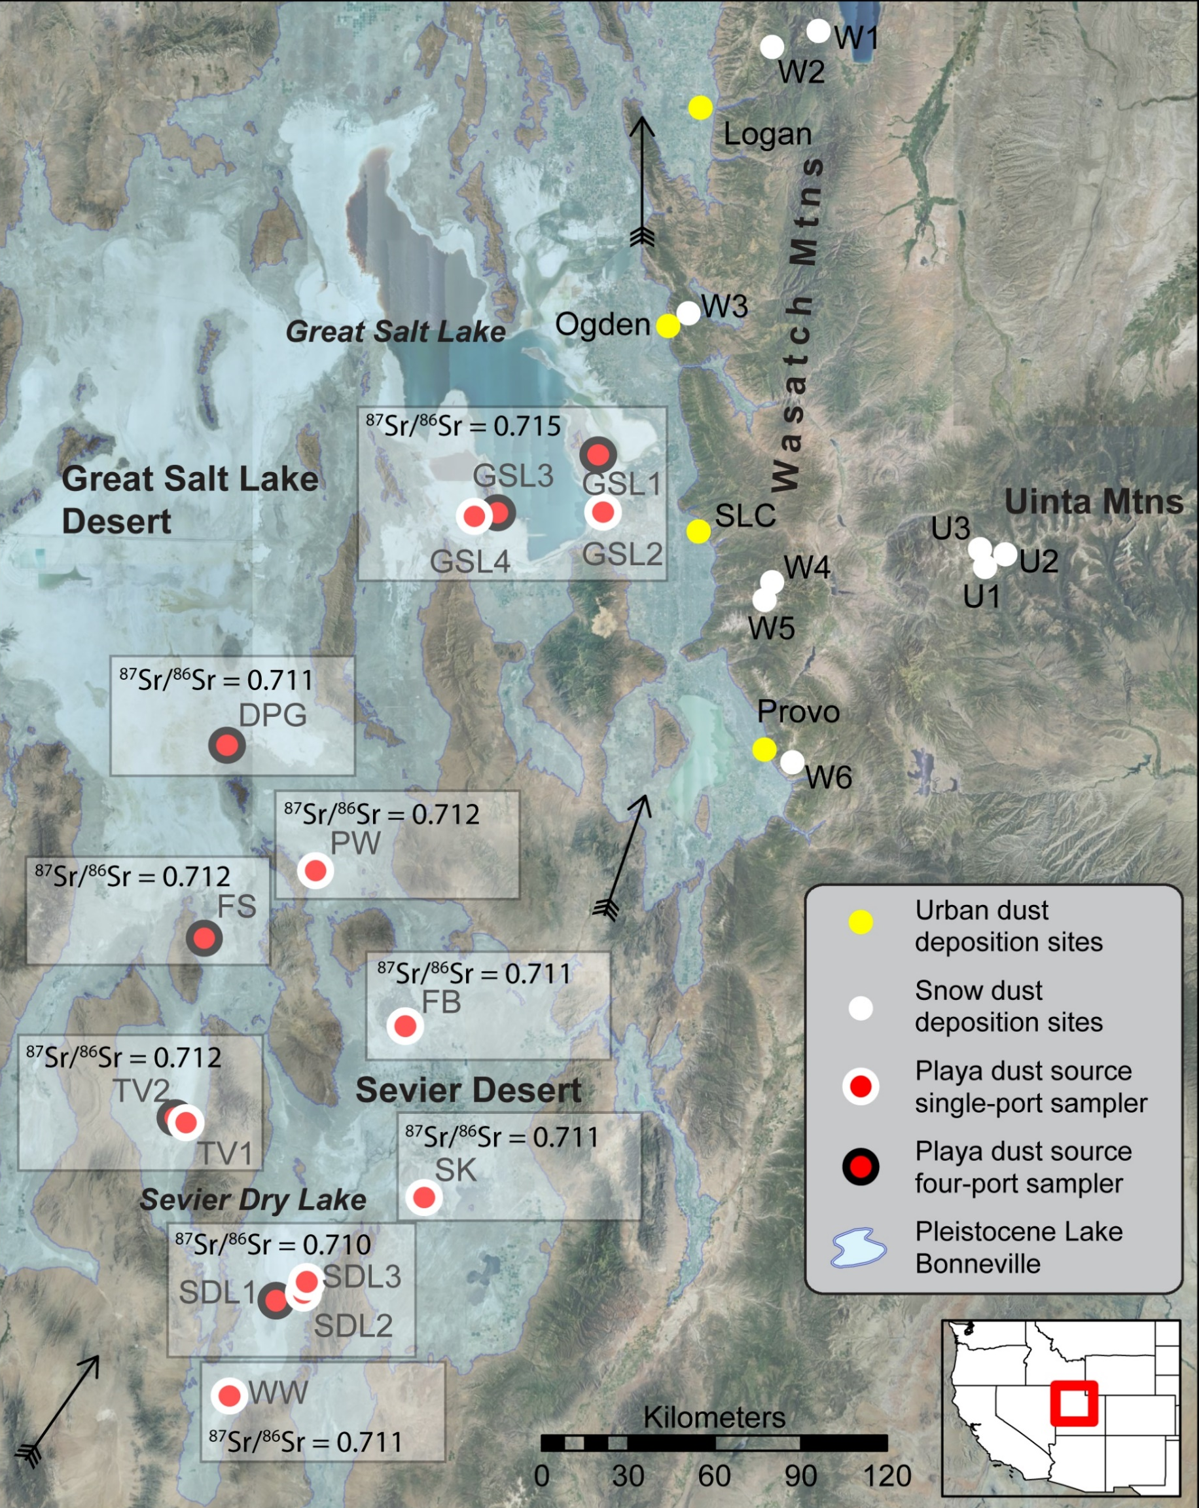
Variable ⁸⁷Sr/⁸⁶Sr Ratios in Playa Dust
Remote sensing indicates Great Salt Lake shoreline (0.715) and Sevier Dry Lake (0.710) produce highest dust emissions
Other playas (0.711-0.712) produce less dust
Notes:
Focus on SDL and GSL – biggest differences and major sources (based on remote sensing)
Abbreviations: GSL = Great Salt Lake, DPG = Dugway Proving Ground, PW = Pismire Wash, FS = Fish Springs, TV = Tule Valley, SDL = Sevier Dry Lake, WW = Wah Wah, SK = Sunstone Knoll, FB = Fumarole Butte, W = Wasatch, U = Uintas, SLC = Salt Lake City.

Slide 7
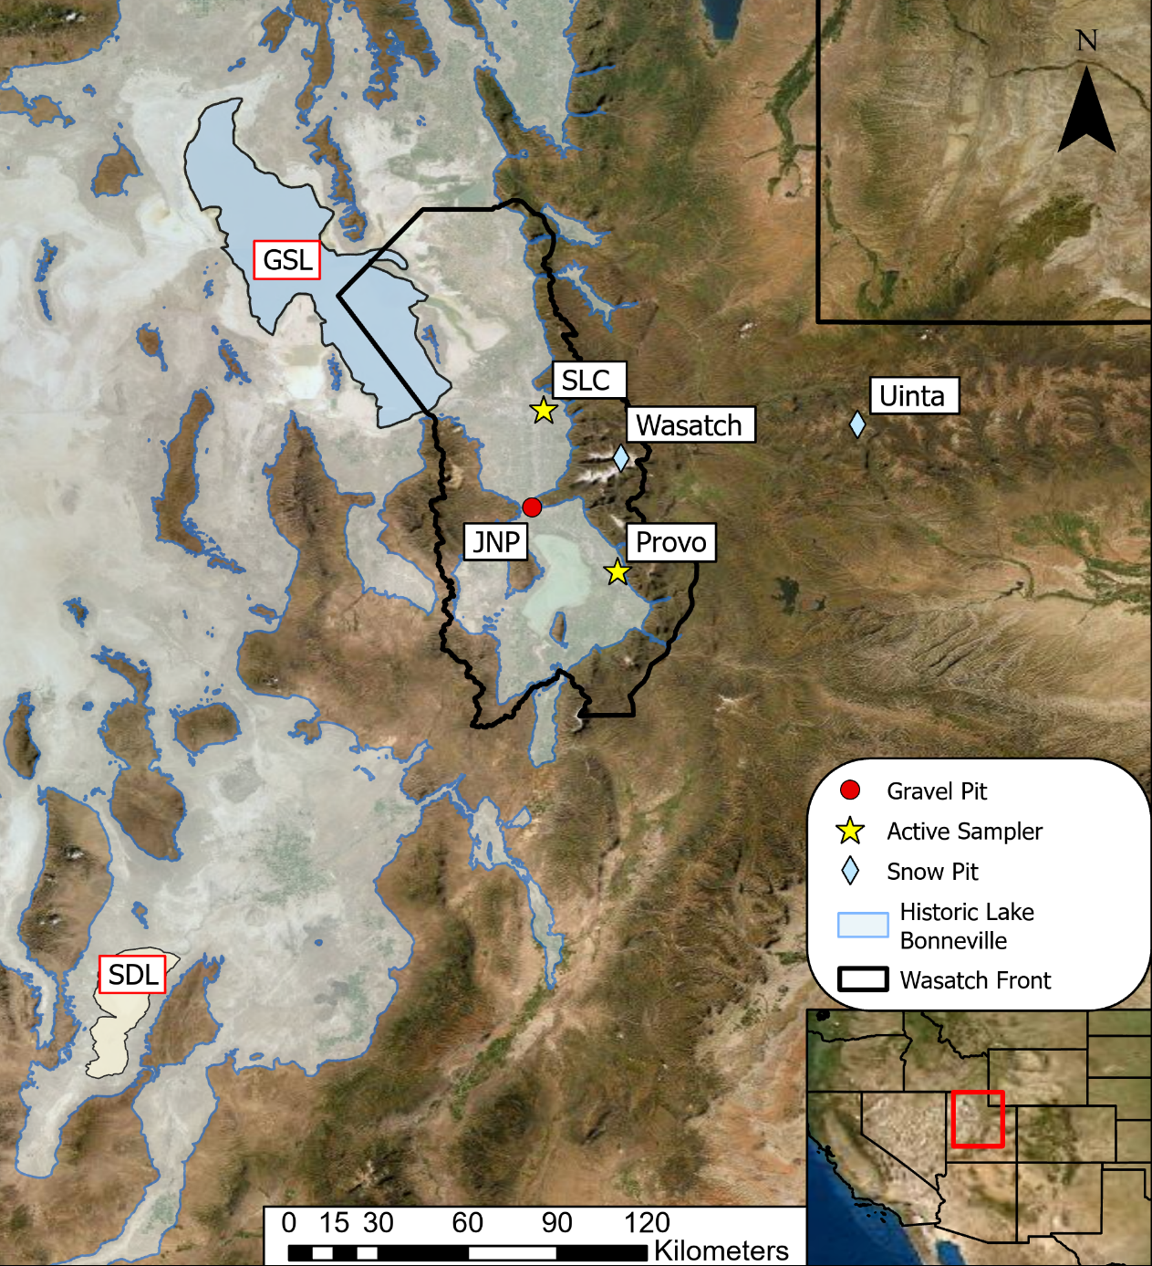
Dust Samples
2008 - 2009 samples from UDAQ Hawthorne (Salt Lake City) site
30 24-hr PM₁₀ filters from 8/08 to 9/09 analyzed
Includes known dust event days and other conditions
2019 - 2020 samples from BYU (Provo) site
39 PM_{2.5}, PM₁₀, and TSP samples from 7/19 to 12/20 analyzed
2 weeks required to collect sufficient material for analysis
7

Slide 8
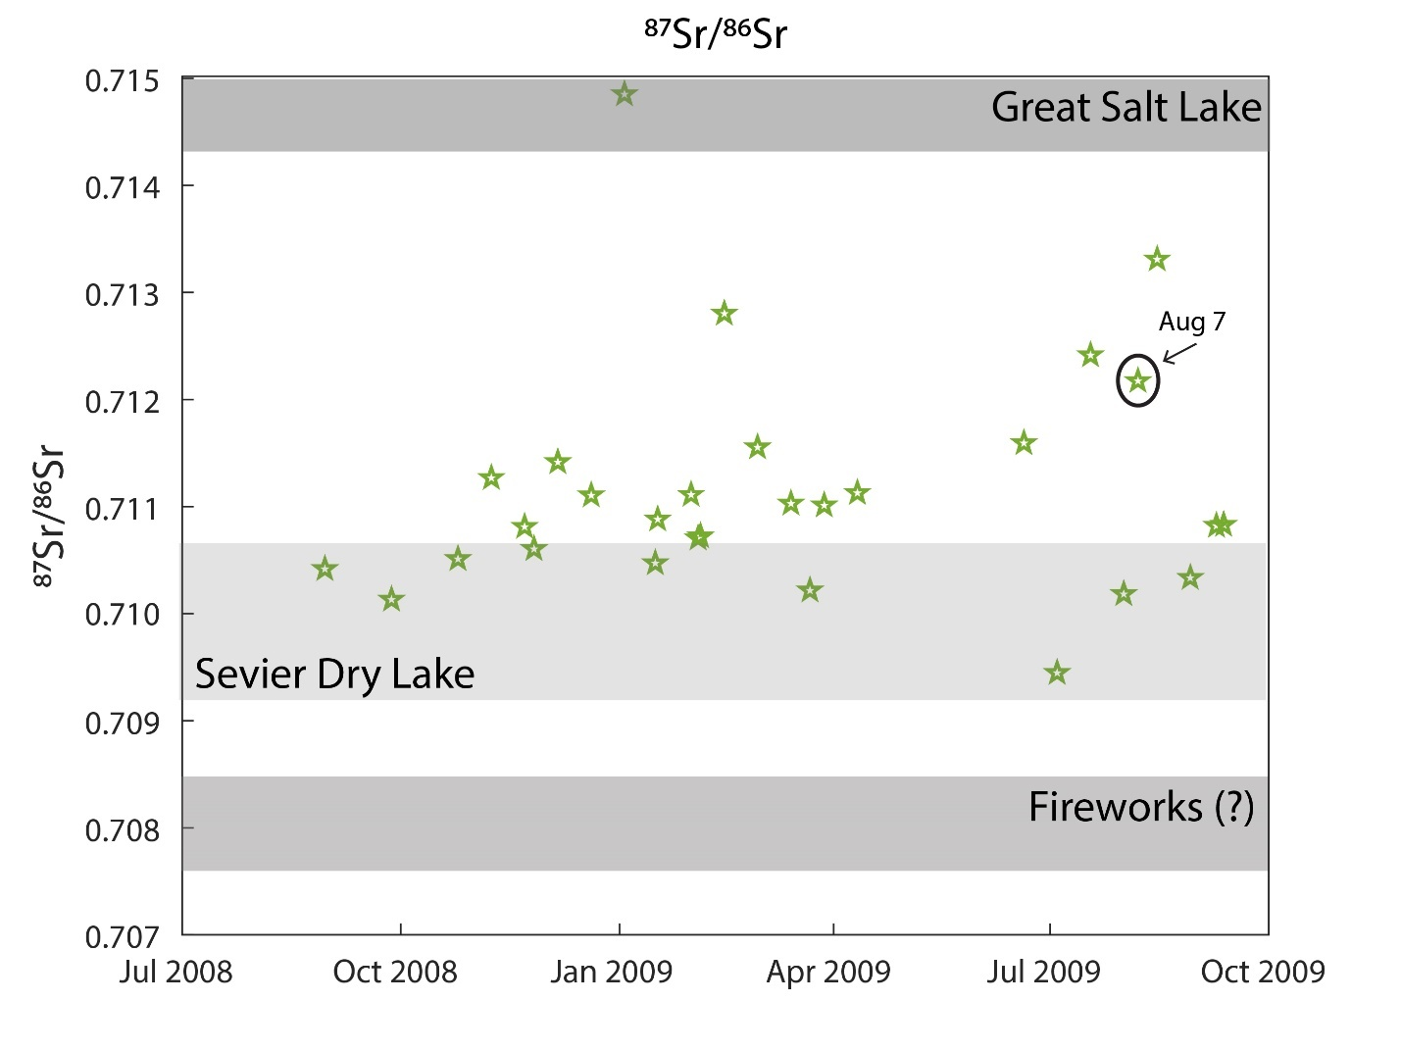
Hawthorne Sample Analysis – August 2009
Sr isotope (⁸⁷Sr/⁸⁶Sr) ratios measured August 2008 through September 2009
Higher values reflect dust from GSL, lower values from SDL
0.711-0.713 values likely reflect combination of GSL and SDL dust
Lowest ⁸⁷Sr/⁸⁶Sr ratio was July 2009, reflecting Sr from firework smoke
Large dust mass on August 7, 2009 sample suggests dust event – ratios indicate combination of GSL and SDL dust (0.7122)
Notes:
Need different isotope measurements (tracers like lithium, sulfur, neodymium, etc) to distinguish “other” playas. So far no luck.

Slide 9
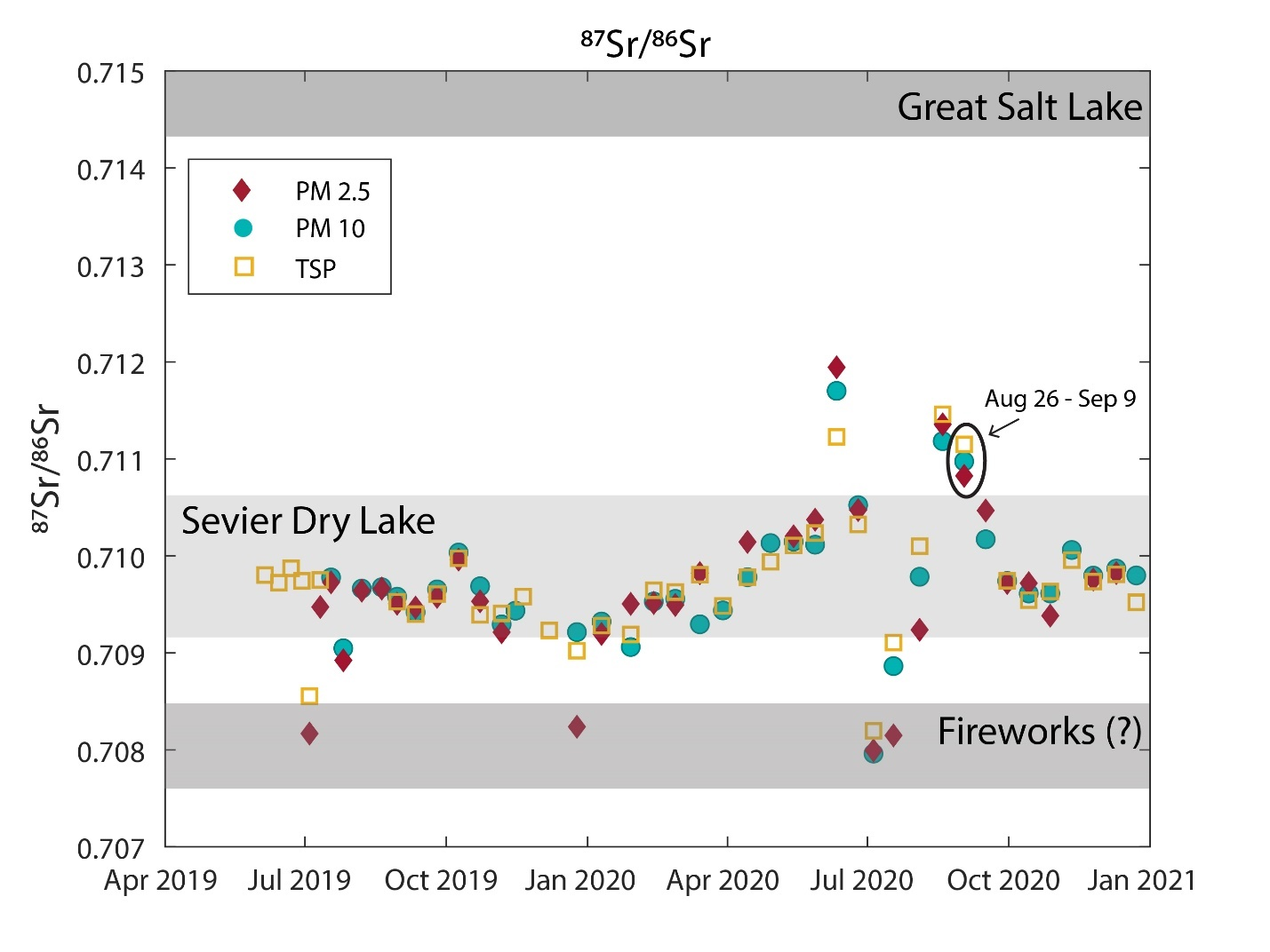
BYU Sample Analysis – September 2020
⁸⁷Sr/⁸⁶Sr ratios measured from June 2019 through December 2020
Most dust from SDL; higher values during spring and fall 2020 suggest some dust inputs from GSL
Lower values during July 2019 and 2020 are likely Sr-rich particles from firework smoke
Dust event on September 8, 2020, captured on filters in place from August 26 – September 9, 2020. Suggests mostly SDL dust sources (0.711)
Notes:
2-week sampling period has potential to collect dust from multiple sources. Historically, Provo site collects most dust from SDL.

Slide 10
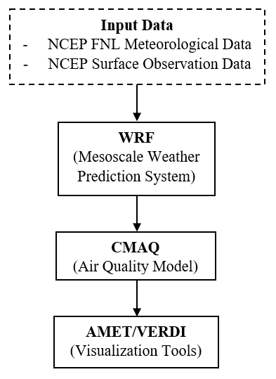
WRF – CMAQ Dust Modeling
Meteorological and land use data taken from national databases (NCEPT FNL, NLCD, MODIS)
WRF 4.2.1 calculates met data, land use, soil type
Surface conditions updated with OBSGRID
PX-LSM required when running CMAQ for dust
CMAQ 5.3.1 calculates dust emissions and transport
No chemical reactions (no emission inputs required)
User Guide: https://doi.org/10.26067/FACPUB/5515
Notes:
Significant effort to get software framework working. Produced User Guide for modeling process

Slide 11
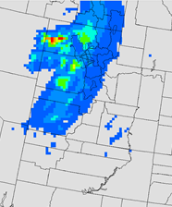
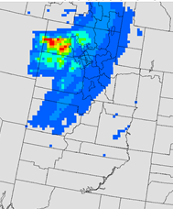
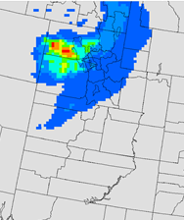
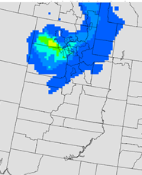
Predicted Dust Concentrations – 8/7/09
Initial flow southwest to northeast
Storm front from northwest
Dust from SDL carried northeast
Dust from GSL carried east
Suggests combination of dust from GSL and SDL at sampling site (0.7122 measured)
Sample site does not capture severity of dust
10-m wind velocity 0 – 20 m/s
0:00 UTC
1:00 UTC
2:00 UTC
3:00 UTC
Dust concentration 0 – 300 μg/m³
Notes:
High winds = high emissions except GSL; 6-9 pm local time; smaller amounts of dust originating from SDL region (carried southwest to northeast) and greater amounts originating from the GSLD (carried east).

Slide 12
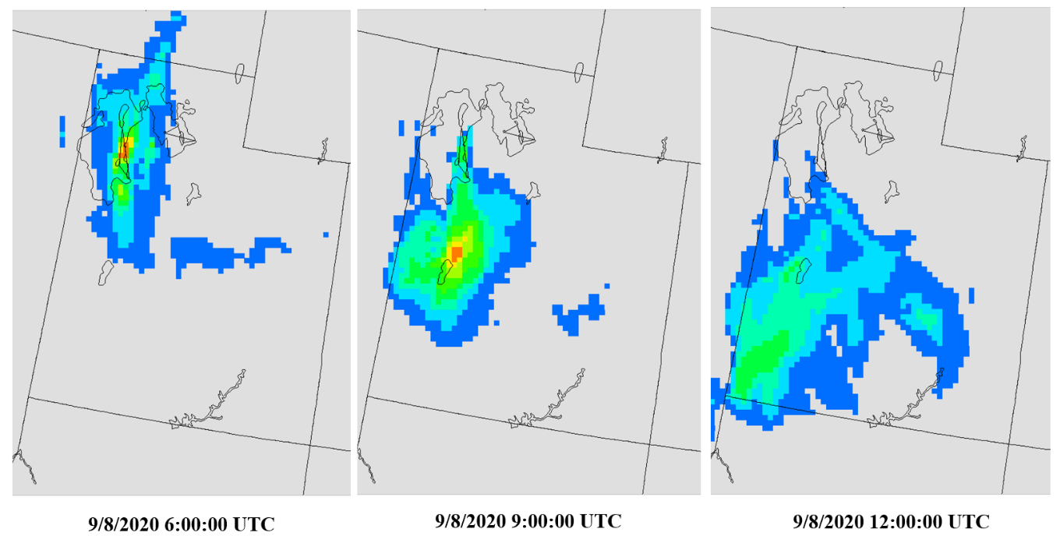
Predicted Dust Concentrations – 9/8/20
Initial winds from north to south along west border
Storm front creates flow west to east near sample site
Dust originally from GSL, then from SDL
Likely combination of GSL and SDL dust carried to sample site (0.711)
Other dust during 2-week sampling period could bias measurement
Predictions provide insight into complexity of dust emission and transport; may suggest need for additional characterization of sources
10-m wind velocity 0 – 20 m/s
Dust concentration 0 – 316 μg/m³
12
Notes:
Highest wind over GSL

Slide 13
Summary
Strontium isotope ratios from filter samples were used in combination with dust predictions from CMAQ to identify emission sources during Utah dust events on 8/7/09 and 9/8/20
Measurements suggested a combination of dust sources originating from Great Salt Lake area and Sevier Dry Lake were transported to sample sites
Predictions of complex dust emissions and transport patterns confirmed dust from multiple origins reached sample sites
Measurements provide “reality” of dust origins, predictions provide “completeness” of dust emission and transport
Predictions may suggest need for additional characterization of sources
13

Slide 14
Acknowledgments
Funding for this research was provided by the Utah Division of Air Quality, Science for Solutions Contract #200762
Ariel Cable of the BYU Air Quality Research Lab compiled and edited the “User Guide for Dust Modeling Using CMAQ 5.3.1 and WRF 4.2.1” https://doi.org/10.26067/FACPUB/5515
14

